Slide 1


IE1020 Network Fundamentals
Group Number: MLB_WD_CSNE_01.01_05

Slide 2
Content
Introduction
Logical Topology
Physical Topology
Devices
Media Types
LAN / WAN Technologies
Protocols
IP Addressing Schema

Slide 3
INTRODUCTION
XYZ University is a large university with 7 branches located throughout the country. The university has over 50,000 students, faculty, and staff members who rely heavily on the university's network for research, communication, and learning. The university's IT department is responsible for designing and maintaining the network infrastructure for all the campuses.

Slide 4
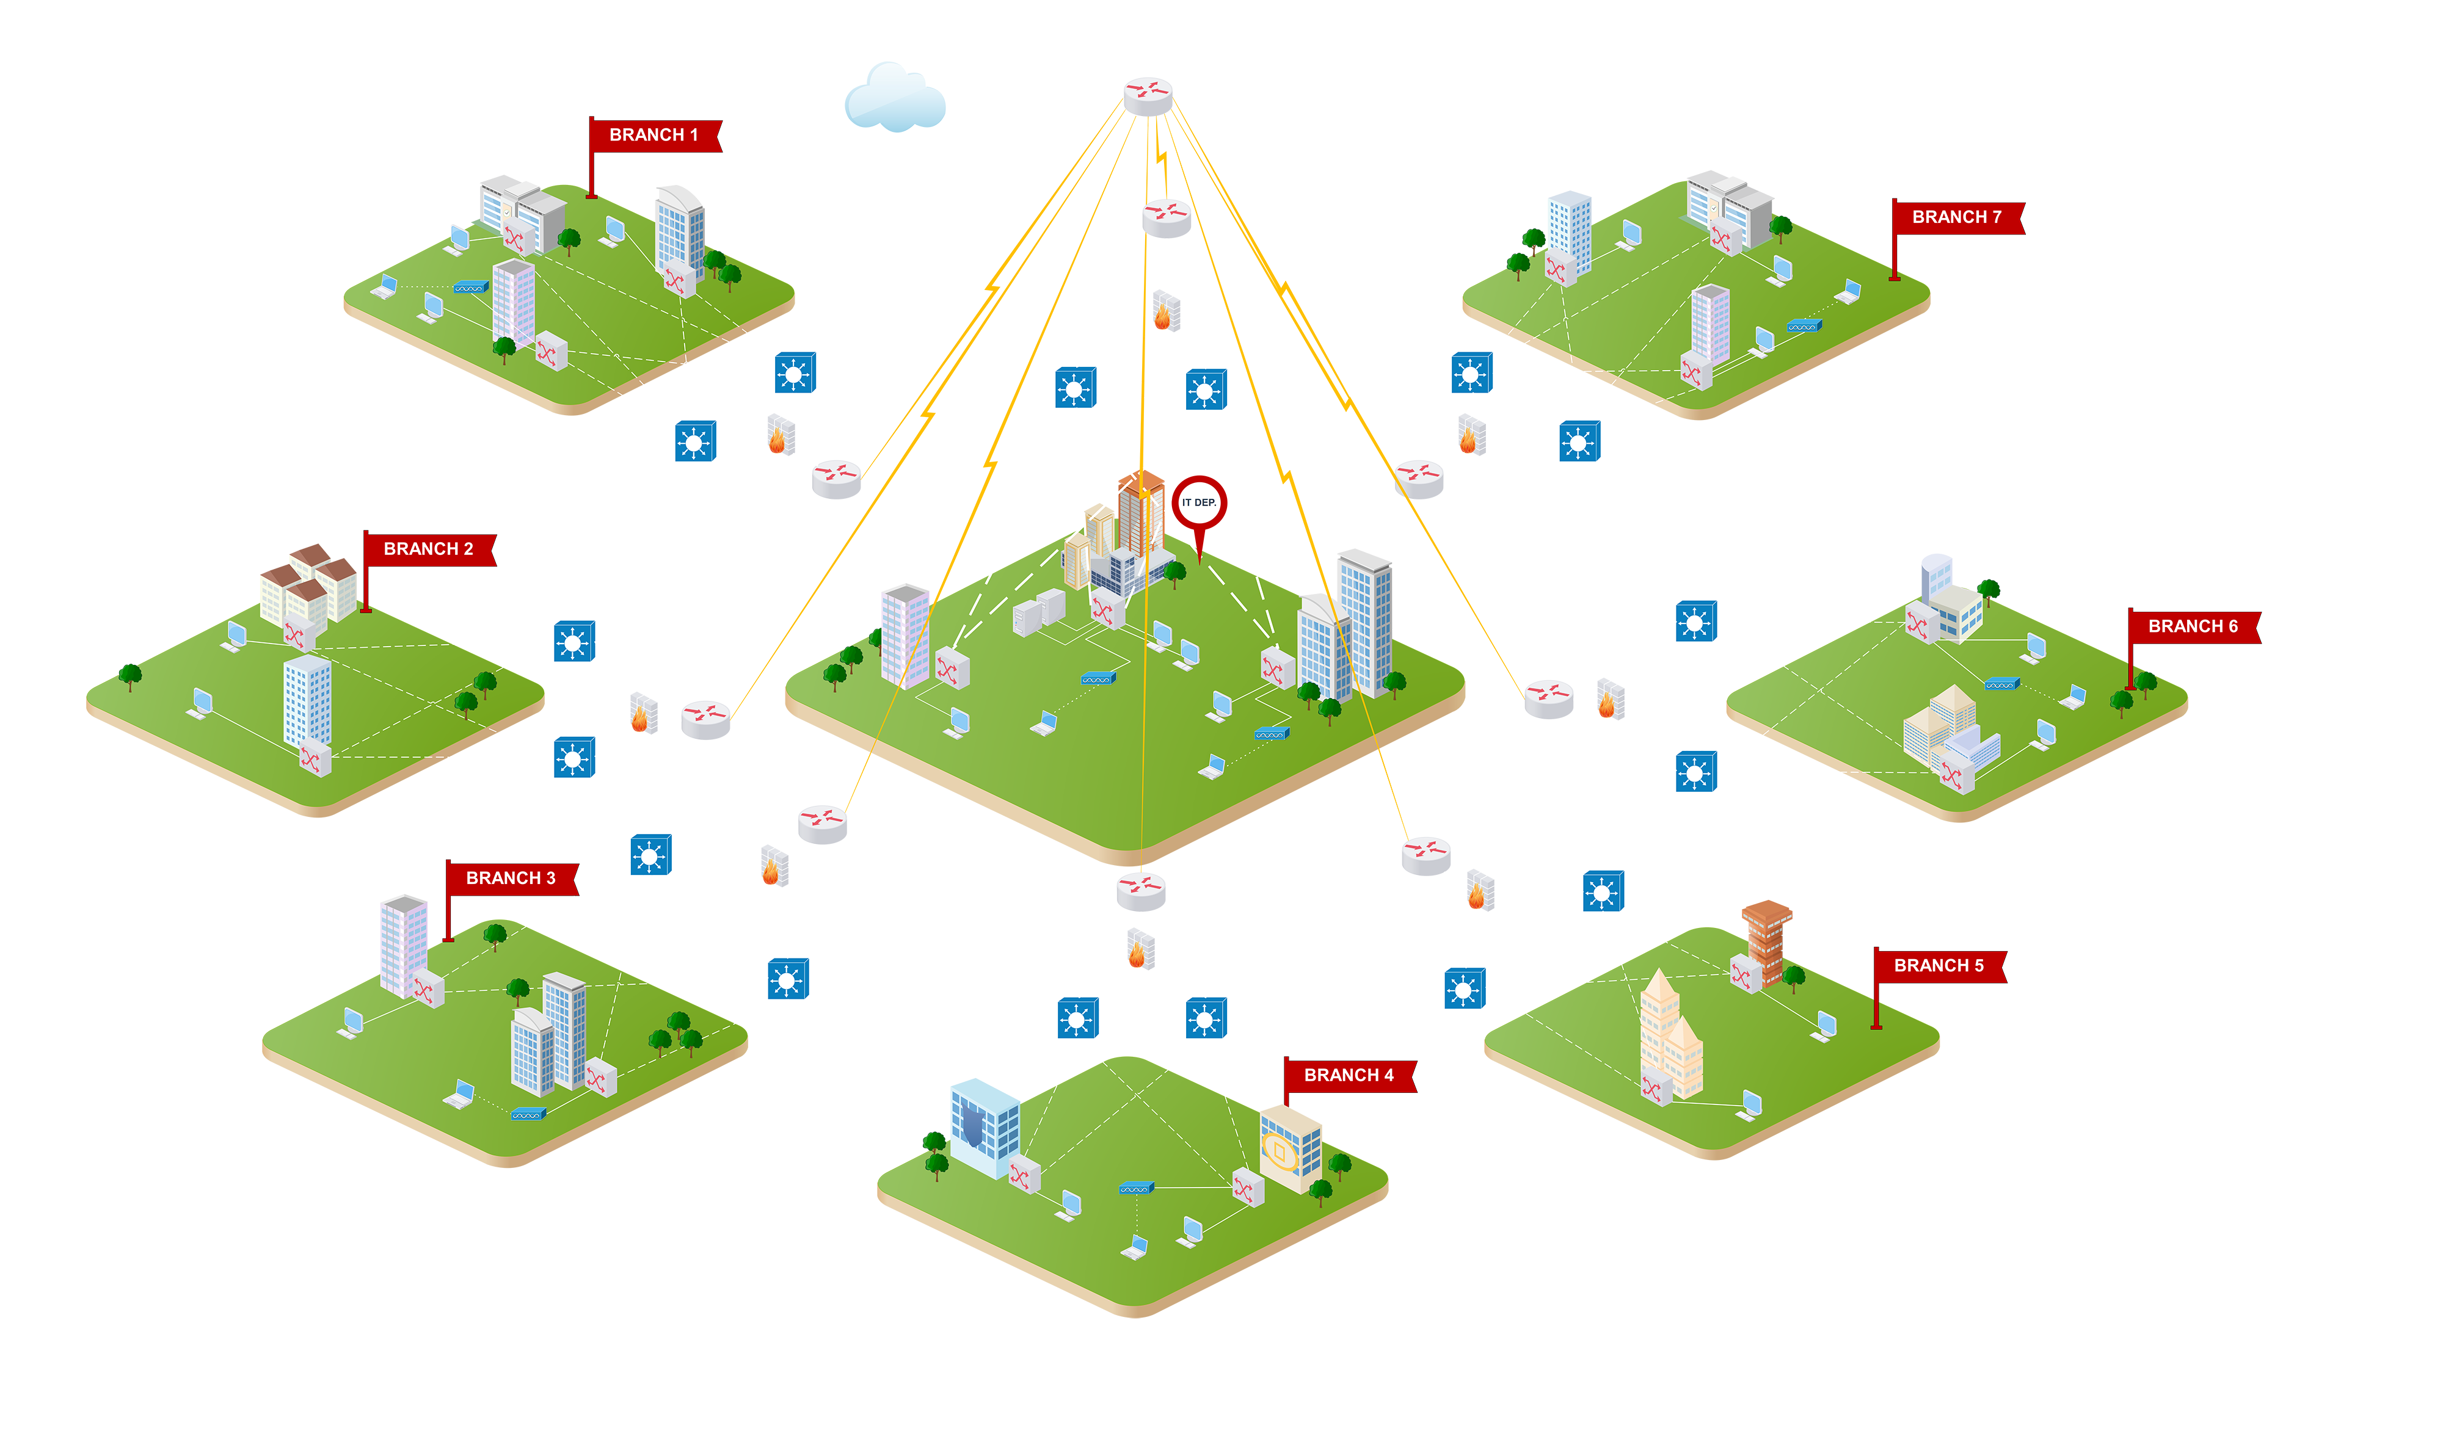
LOGICAL TOPOLOGY
RANAWAKA R A S M IT22320728

Slide 5
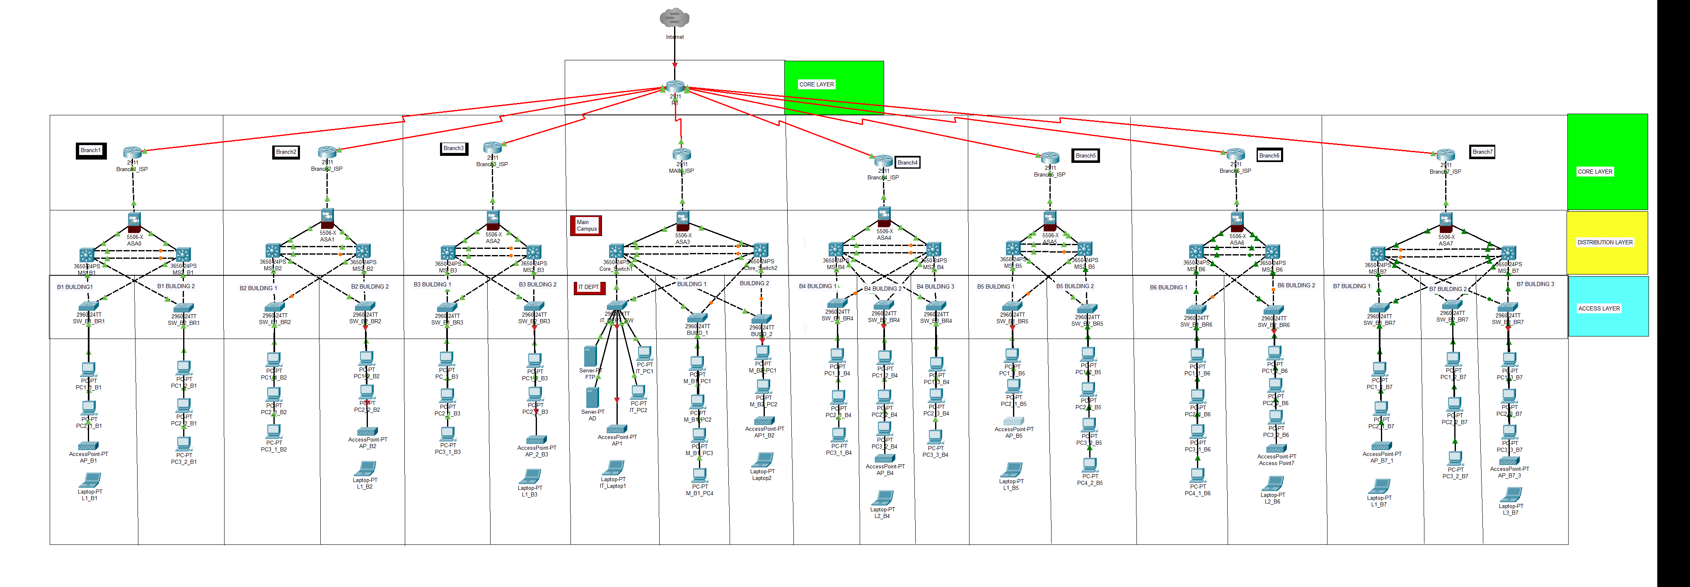

LOGICAL TOPOLOGY
Logical topology refers to the way in which devices & systems are logically interconnected in a computer network. It describes the path that data follows as it travels between devices & the logical arrangement of those devices. Logical topology focuses on the flow of information & how devices communicate with each other.

Slide 6
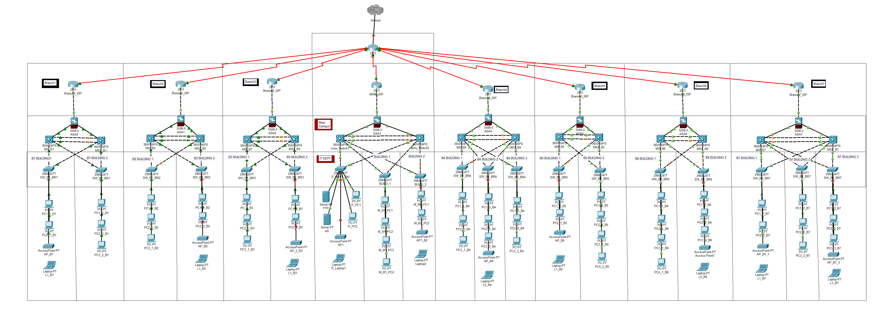
LOGICAL TOPOLOGY

Slide 7
LOGICAL TOPOLOGY
CORE LAYER
DISTRIBUTION LAYER
ACCESS LAYER

Slide 8
LOGICAL TOPOLOGY
Access layer has end devices and switches. The IT department is in the main building. The distribution layer in every building has multiple switches to make the data redundant & act as a backup in case one fails. In addition, it contains a firewall which obstructs unauthorized access. The building resides in the main building, where it collaborates with the other branches because every branch has a core router which is interconnected to the main router.

Slide 9
Physical TOPOLOGY
DEWARATHNE P S IT22004536

Slide 10
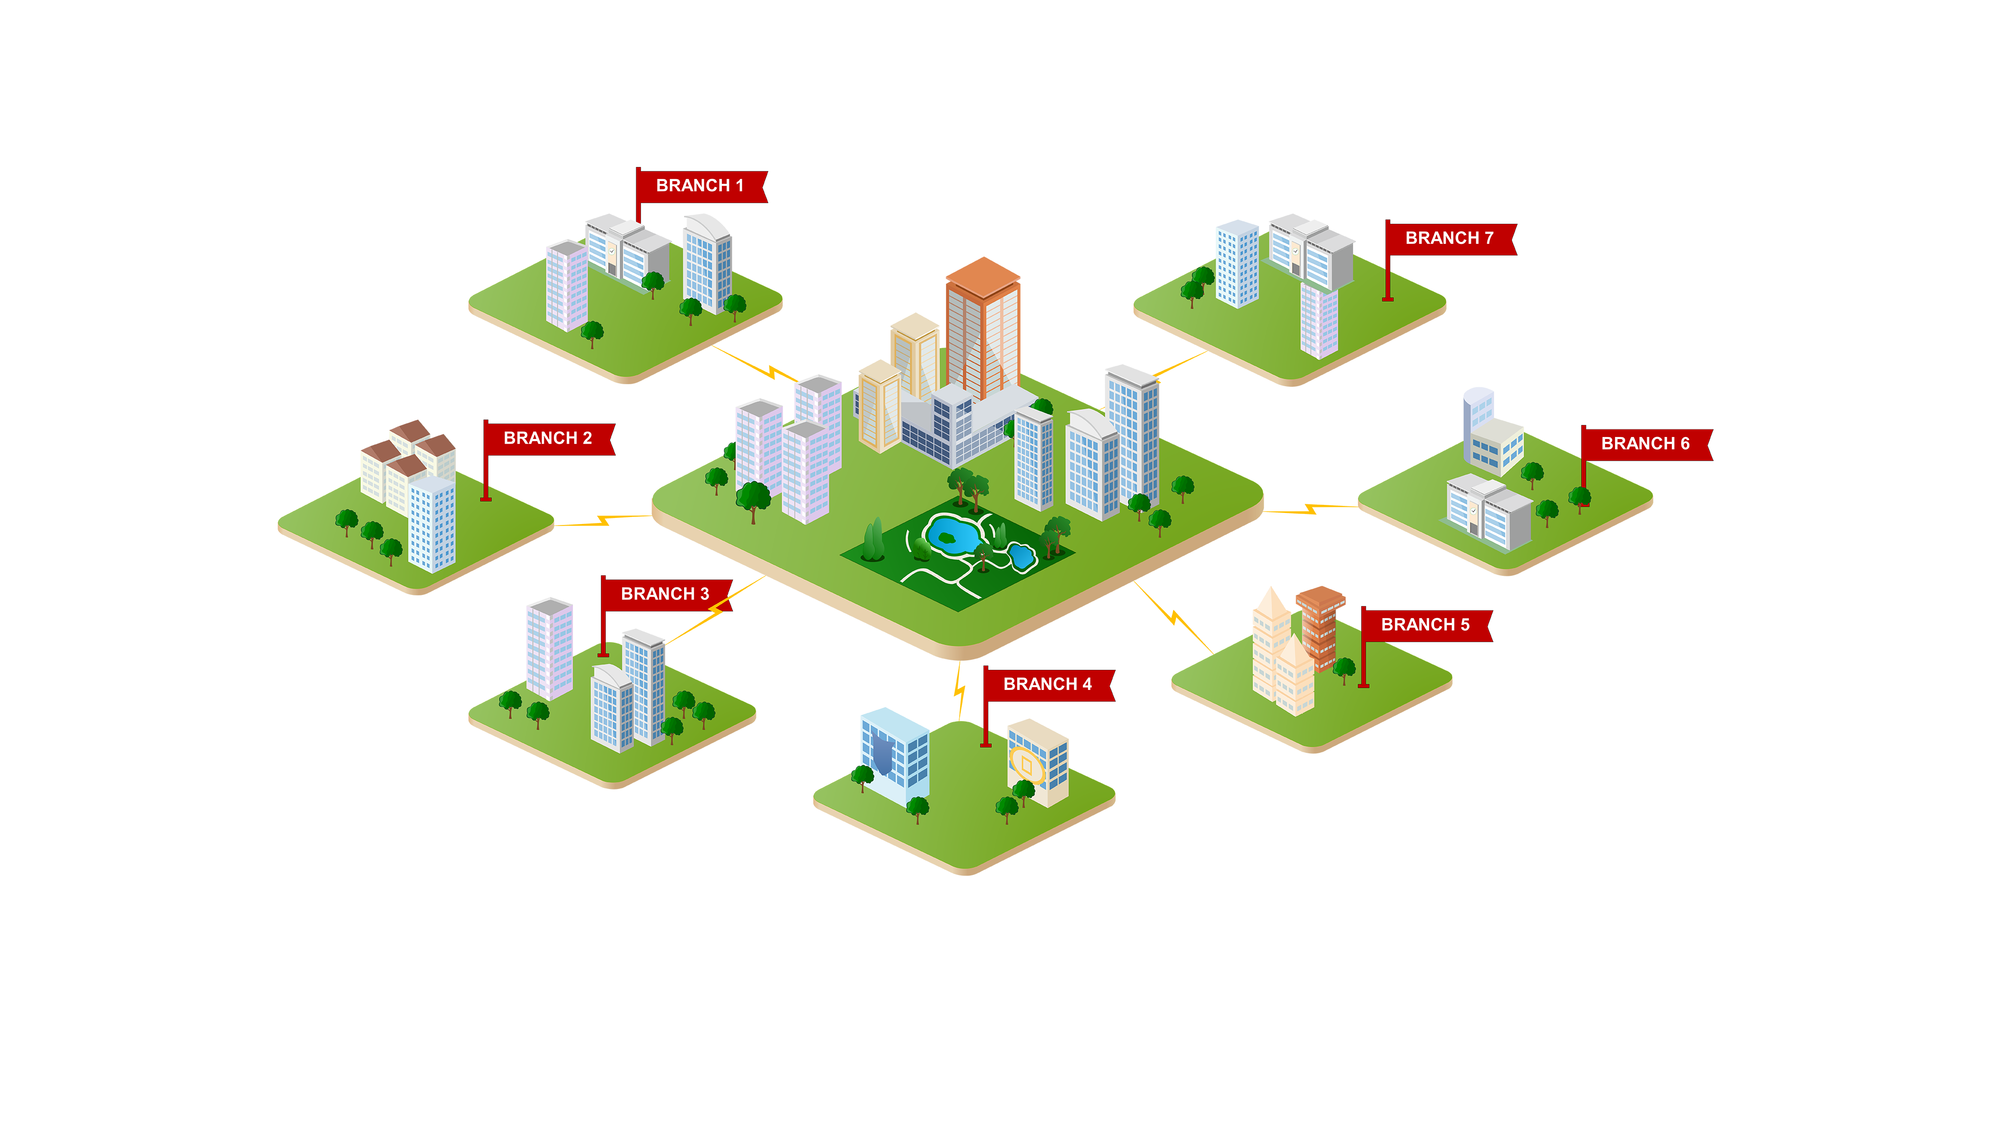
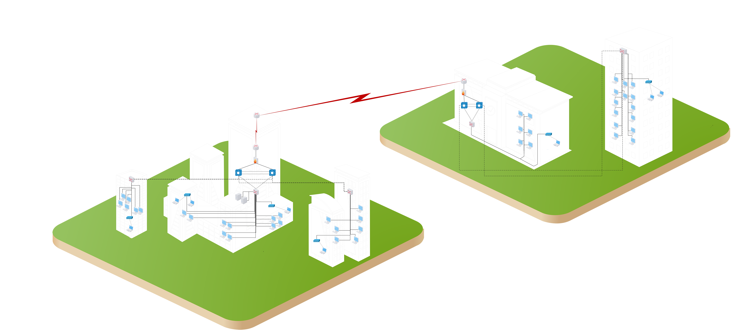
PHYSICAL TOPOLOGY

Slide 11
PHYSICAL TOPOLOGY

Slide 12
PHYSICAL TOPOLOGY

Slide 13
PHYSICAL TOPOLOGY

Slide 14
Devices
HASARA M K IT22308566

Slide 15
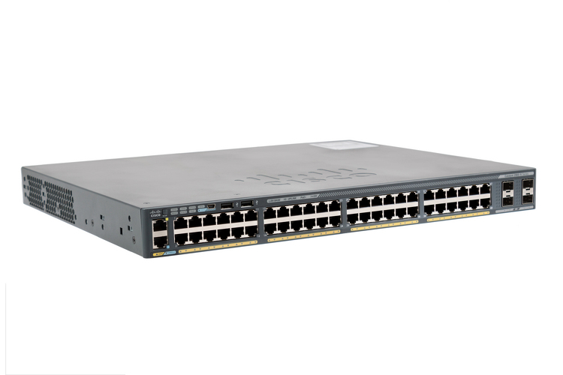
DEVICES
1 ) Access Network
Cisco catalyst 2960-x series switches
Basically, designed for small and medium-sized businesses and campus networks.
Offer a range of features and capabilities to enhance network performance, security and manageability.
Provides multiple gigabit ethernet ports for high-speed connectivity.
Include features like DHCP snooping, IP source guard etc.

Slide 16
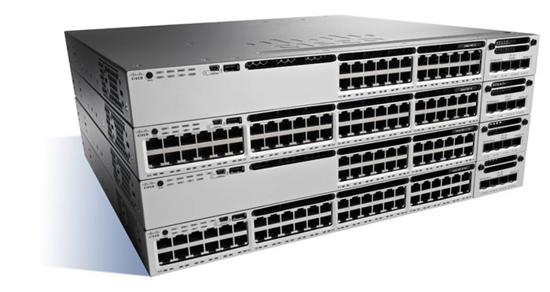
DEVICES
2) Distribution Network
Cisco Catalyst 3850 Series switches
Advanced and fixed-configuration switches.
Designed for enterprise networks.
Offers a wide range of features and capabilities for enhanced network performance, security and management.
Offering high-speed connectivity with options for gigabit ethernet, multigigabit ethernet and 10-gigabit ethernet ports.
Support IP phones, wireless access points and surveillance cameras.

Slide 17
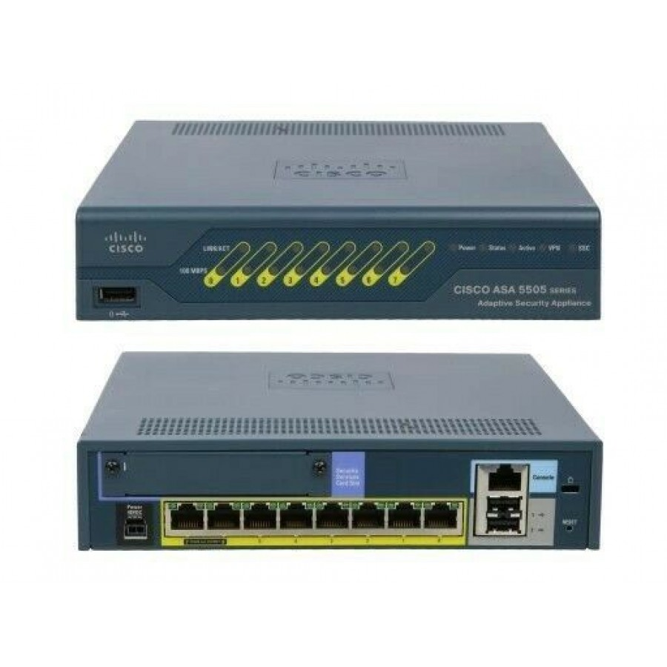
DEVICES
2) Distribution Network
Cisco ASA firewall
It provides firewall, intrusion prevention, and virtual private network (VPN) capabilities to protect networks and applications from unauthorized access and security threats.
Acts as a network firewall.
Remains a widely deployed and supported firewall solution.

Slide 18
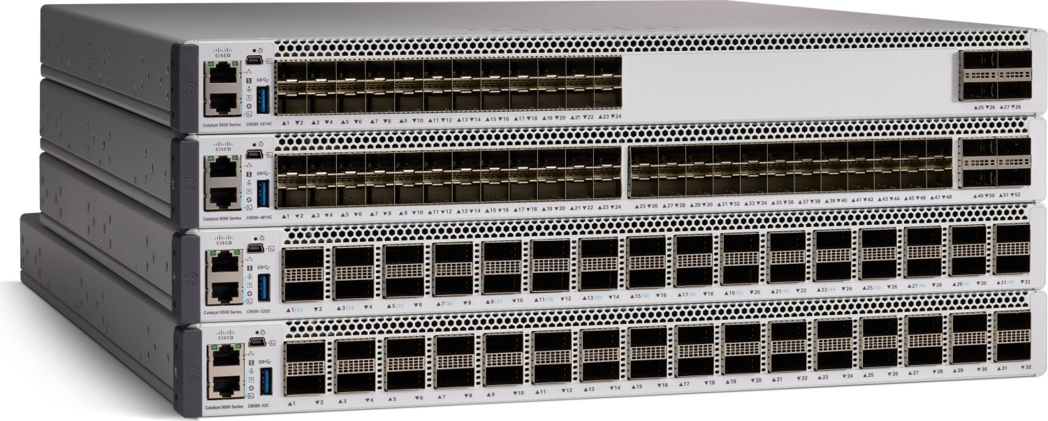
DEVICES
3) Core Network
Cisco Catalyst 9500 Series switches
Designed for High performance, feature-rich and expandable for enterprise networks.
Commonly used in large-scale deployments.

Slide 19
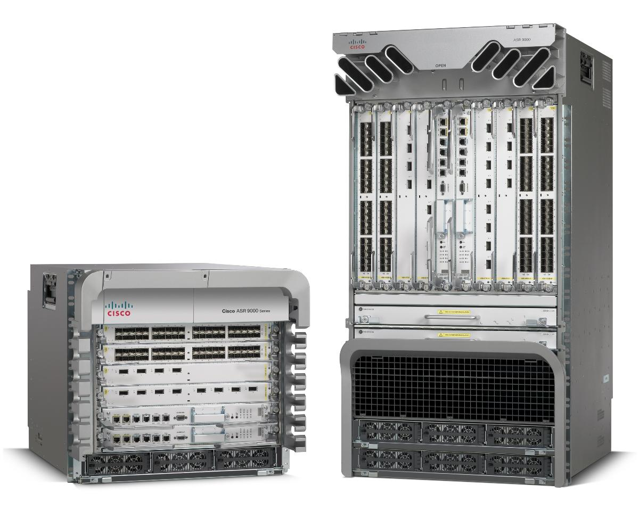
DEVICES
3) Core Network
Cisco ASR 9000 Series routers
Family of routers designed for high-performance, carrier-grade networking and service provider environments
Offer large scalability options to serve growing network requirements.
Feature a modular design, allowing for flexibility and expansion
Offer scalability, reliability, and advanced features.

Slide 20
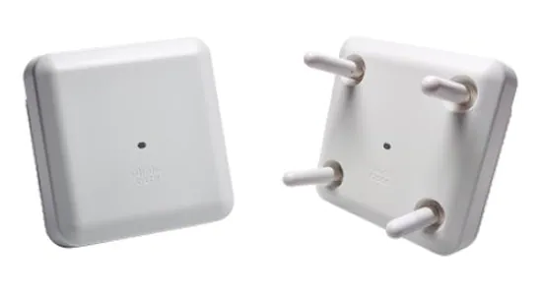
DEVICES
4) Wireless Network
Cisco Aironet 3800 Series access points
Family of high-performance wireless access points designed for enterprise deployments
Provide fast, reliable Wi-Fi connectivity with advanced features to support demanding wireless networks.
These access points support multigigabit Ethernet interfaces, such as 2.5 Gigabit Ethernet and 5 Gigabit Ethernet.

Slide 21
Media Types
GONAGALA G A S T IT22314956

Slide 22
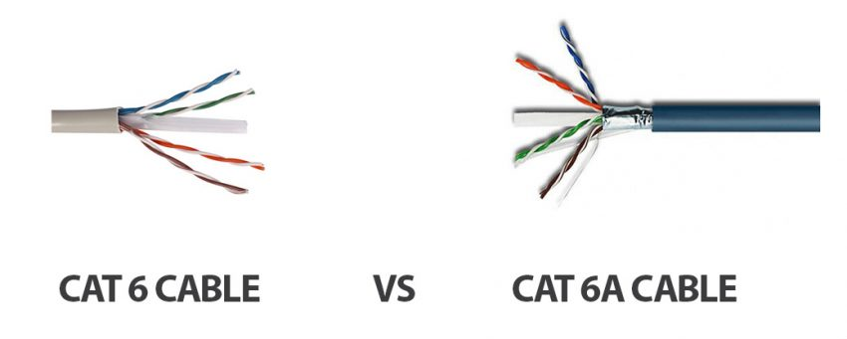
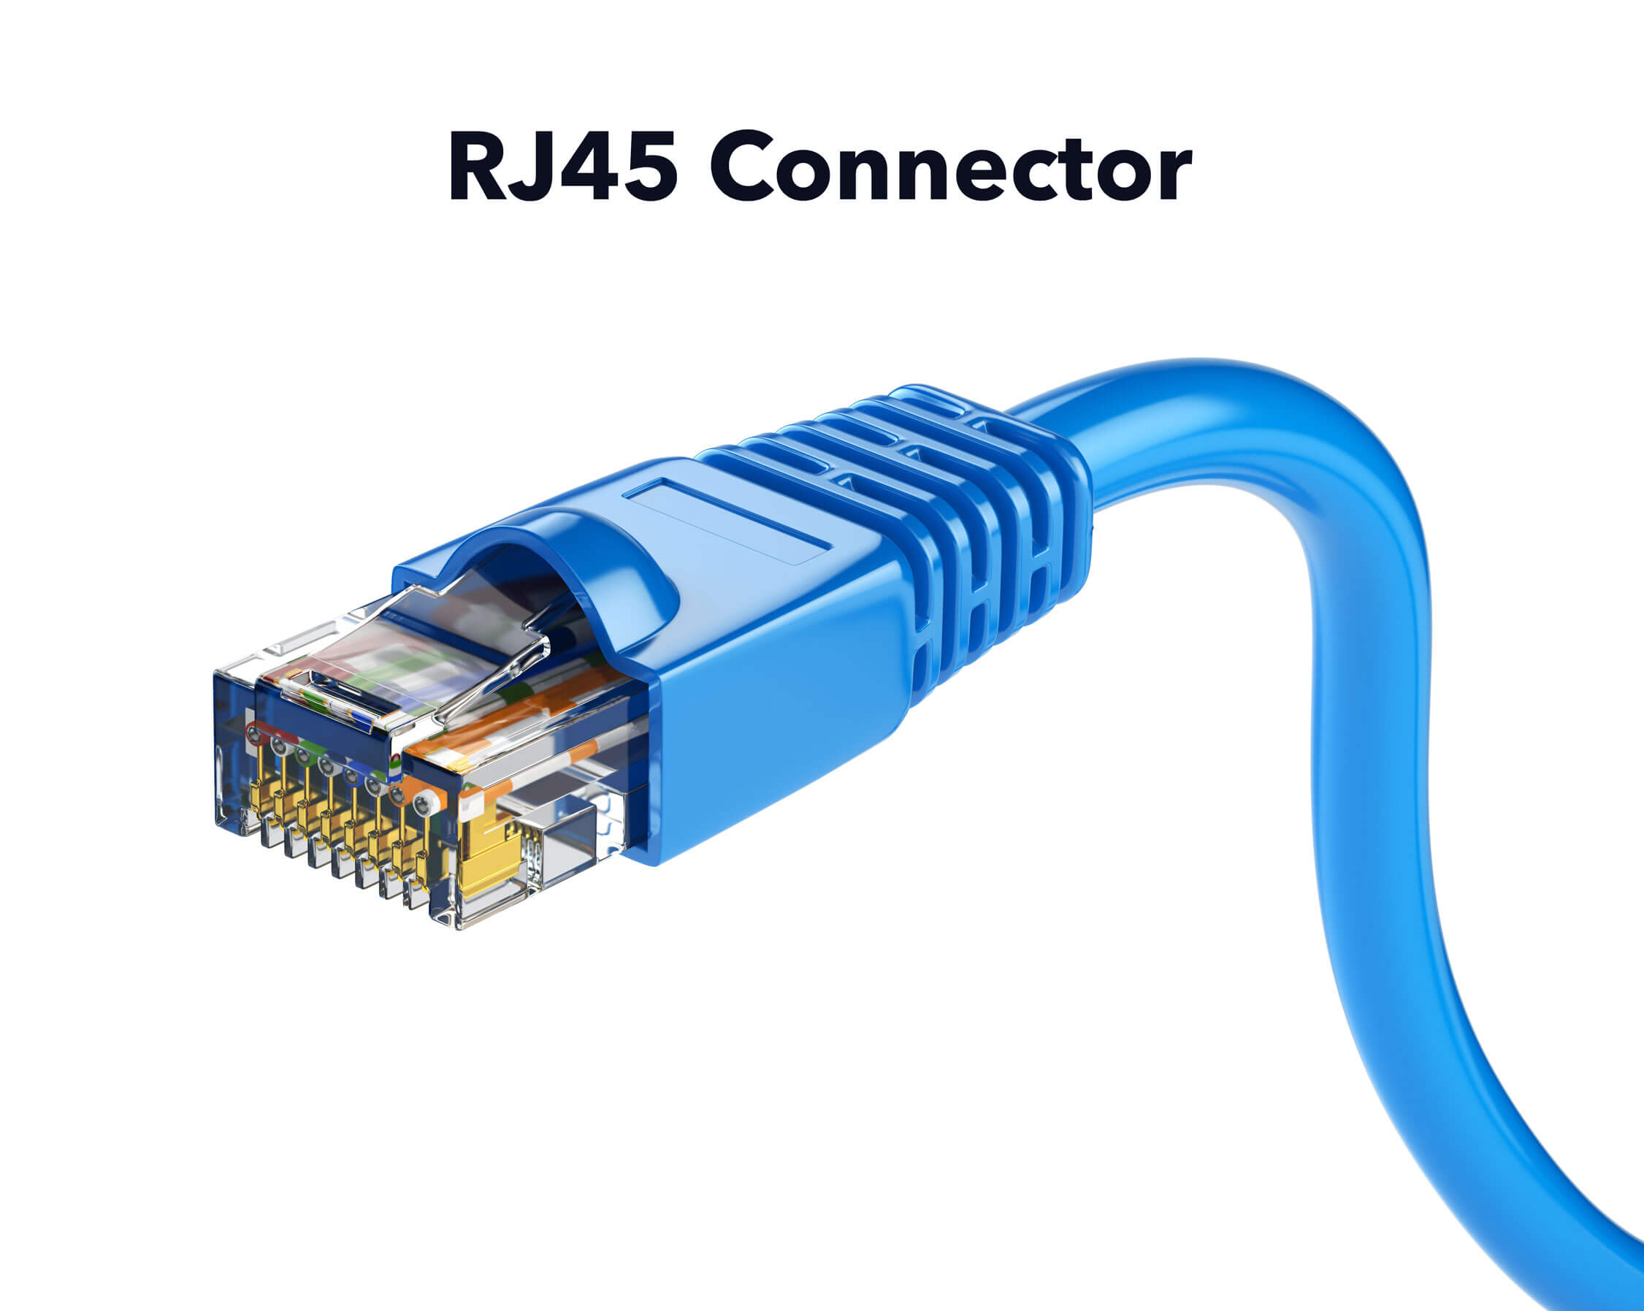
MEDIA TYPES
1) CAT 6/ CAT 6A cables
Provide excellent performance, supporting Gigabit Ethernet speeds and beyond.
Reliable and high-quality data transmission.
Widely available and cost-effective.
RJ-45 connectors, guarantee a secure and standardized connection.

Slide 23

MEDIA TYPES
2) WiFi 6 (802.11ax) standard
Offer high-speed wireless connections, improved capacity, and enhanced security features.
Faster and more dependable wireless connections
Better performance in crowded environments with multiple devices.

Slide 24
LAN / WAN TECHNOLOGIES
GONAGALA G A S T IT22314956

Slide 25
LAN / WAN TECHNOLOGIES
LAN Technologies
Giga - Ethernet
IEEE802.3ab standardize Giga-Ethernet over UTP using CAT-6 cables.
Gigabit Ethernet enables high speeds up to 1000 Mbps throughout each campus building, allowing for rapid data transmission, communication, and resource sharing among devices.
Offers the scalability and performance required to support many users and devices at the University.

Slide 26
LAN / WAN TECHNOLOGIES
WAN Technologies
Point-to-point (P2P) leased lines
P2P leased lines create dedicated connections between branches, providing secure and high-bandwidth communications.
Ensure constant and reliable communication between campuses, allowing for effective resource sharing, data transfer, and branch collaboration.

Slide 27
Protocols
PERERA P A I P IT22884824

Slide 28
PROTOCOLS
LAYER | PROTOCOLS
(7) Application Layer | HTTP, SMTP, DNS, FTP
(6) Presentation Layer | SSL, TLS
(5) Session Layer | NetBIOS, SSH, SIP, RTP
(4) Transport Layer | TCP, UDP
(3) Network Layer | IPv4, IPv6, ICMP, OSPF, EIGRP
(2) Data Link Layer | Ethernet (IEEE 802.3), IEEE 802.1X, Wi-Fi (IEEE 802.11)
(1) Physical Layer | Ethernet (IEEE 802.3), Wi-Fi (IEEE 802.11)
LAYER
(7) Application Layer
(6) Presentation Layer
(5) Session Layer
(4) Transport Layer
(3) Network Layer
(2) Data Link Layer
(1) Physical Layer

Slide 29
PROTOCOLS
Application – HTTP, SMTP, DNS, FTP. These protocols enable web browsing, email communication, domain name resolution, and file transfer services within the campus network.
Presentation - SSL/TLS for secure communication and encryption of data, preventing unauthorized access within the campus network.
Session – NetBIOS, SSH, SIP, RTP. These protocols establish and manage sessions between network devices for communication and remote access.
LAYER | PROTOCOLS
(7) Application Layer | HTTP, SMTP, DNS, FTP
(6) Presentation Layer | SSL, TLS
(5) Session Layer | NetBIOS, SSH, SIP, RTP
(4) Transport Layer | TCP, UDP
(3) Network Layer | IPv4, IPv6, ICMP, OSPF, EIGRP
(2) Data Link Layer | Ethernet (IEEE 802.3), IEEE 802.1X, Wi-Fi (IEEE 802.11)
(1) Physical Layer | Ethernet (IEEE 802.3), Wi-Fi (IEEE 802.11)
LAYER
(7) Application Layer
(6) Presentation Layer
(5) Session Layer
(4) Transport Layer
(3) Network Layer
(2) Data Link Layer
(1) Physical Layer

Slide 30
Transport - TCP (Transmission Control Protocol) for reliable, connection-oriented data transfer. UDP (User Datagram Protocol) for fast, connectionless data transfer over the campus network
TCP – accessing shared resources / submitting assignments.
UDP – Video Streaming / Online Learning Session
Network Layer – IP (IPv4 and IPv6) for addressing and routing packets between networks.
OSPF (Open Shortest Path First) or EIGRP (Enhanced Interior Gateway Routing Protocol) for dynamic routing within the university network
PROTOCOLS
LAYER | PROTOCOLS
(7) Application Layer | HTTP, SMTP, DNS, FTP
(6) Presentation Layer | SSL, TLS
(5) Session Layer | NetBIOS, SSH, SIP, RTP
(4) Transport Layer | TCP, UDP
(3) Network Layer | IPv4, IPv6, ICMP, OSPF, EIGRP
(2) Data Link Layer | Ethernet (IEEE 802.3), IEEE 802.1X, Wi-Fi (IEEE 802.11)
(1) Physical Layer | Ethernet (IEEE 802.3), Wi-Fi (IEEE 802.11)

Slide 31
Data Link - Ethernet (IEEE 802.3) for framing and transmitting data over the local network. IEEE 802.1X for port-based network access and IEEE 802.11 provides wireless communication.
Physical - Ethernet (IEEE 802.3) for the physical transmission of data over the network and IEEE 802.11 for wireless communication.
Ethernet
10 Mbps
100 Mbps (Fast Ethernet)
1 Gbps (Gigabit Ethernet)
10 Gbps (10 Gigabit Ethernet)
Wireless (IEEE 802.11)
802.11b
802.11g
802.11n
802.11ac
802.11ax
PROTOCOLS
LAYER | PROTOCOLS
(7) Application Layer | HTTP, SMTP, DNS, FTP
(6) Presentation Layer | SSL, TLS
(5) Session Layer | NetBIOS, SSH, SIP, RTP
(4) Transport Layer | TCP, UDP
(3) Network Layer | IPv4, IPv6, ICMP, OSPF, EIGRP
(2) Data Link Layer | Ethernet (IEEE 802.3), IEEE 802.1X, Wi-Fi (IEEE 802.11)
(1) Physical Layer | Ethernet (IEEE 802.3), Wi-Fi (IEEE 802.11)

Slide 32
IP ADDRESSING SCHEMA
PERERA P A I P IT22884824

Slide 33
IP Addressing SCHEMA
Major Network - 172.16.0.0 / 16
It provides 65,536 Ip addresses.
Main Campus – 16,000
1, 2, 3 branches – 8,000
4, 5, 6, 7 branches – 4,000

Slide 34
IP Addressing SCHEMA
Subnet name | Needed Size | Allocated Size | Address | Mask | Assignable Range | Broadcast
Main Campus | 16000 | 16382 | 172.16.0.0 | /18 | 172.16.0.1 - 172.16.63.254 | 172.16.63.255
Branch 1 | 8000 | 8190 | 172.16.64.0 | /19 | 172.16.64.1 - 172.16.95.254 | 172.16.95.255
Branch 2 | 8000 | 8190 | 172.16.96.0 | /19 | 172.16.96.1 - 172.16.127.254 | 172.16.127.255
Branch 3 | 8000 | 8190 | 172.16.128.0 | /19 | 172.16.128.1 - 172.16.159.254 | 172.16.159.255
Branch 4 | 4000 | 4094 | 172.16.160.0 | /20 | 172.16.160.1 - 172.16.175.254 | 172.16.175.255
Branch 5 | 4000 | 4094 | 172.16.176.0 | /20 | 172.16.176.1 - 172.16.191.254 | 172.16.191.255
Branch 6 | 4000 | 4094 | 172.16.192.0 | /20 | 172.16.192.1 - 172.16.207.254 | 172.16.207.255
Branch 7 | 4000 | 4094 | 172.16.208.0 | /20 | 172.16.208.1 - 172.16.223.254 | 172.16.223.255

Slide 35
Group members
DEWARATHNE P S (Leader) IT22004536
RANAWAKA R A S M IT22320728
HASARA M K IT22308566
PERERA P A I P IT22884824
GONAGALA G A S T IT22314956

Slide 36
thank you

